Slide 1
Lightning Talk 7: Ethics and Professional Responsibility
sddec24-16
Cameron Jones, Blake Hardy, Cayden Kelley, Chase O’Connell, Holden Brown, Tejal Devshetwar

Slide 2
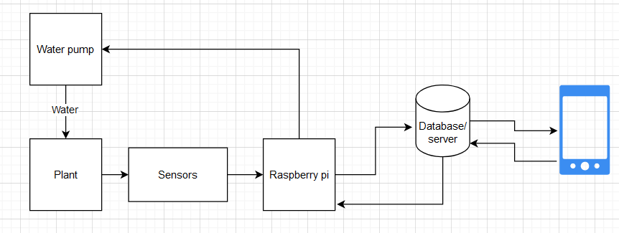
Project Overview
Create a device that automatically collects soil data (NPK,moisture,temperature).
Sends the data to a database on a server.
Create a phone app which presents the collected data of a users soil.
Server has logic that sends commands to automatically water/fertilize plants when certain conditions are met.

Slide 3
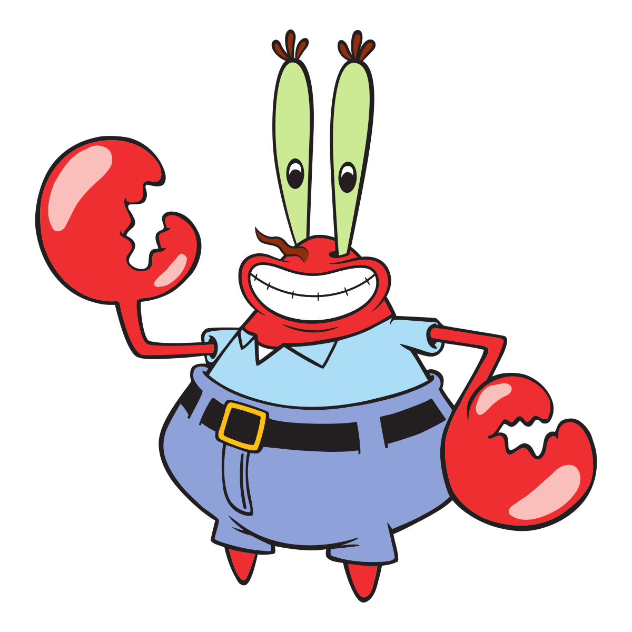
The Good-Financial Responsibility: Relevance
Our project utilizes multiple different sensors, devices and services to operate
The price of these range from a few dollars to thousands of dollars
Without putting in proper consideration to who the project is meant for, the cost of the project could easily balloon in size with little to no actual reason

Slide 4
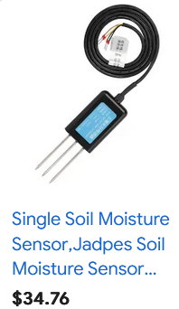
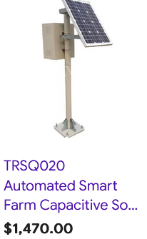
The Good-Financial Responsibility: Our approach
To limit the cost of the project our team considered who the key demographic of the team was and what they may want out of the project
We put additional money into those key areas skimping on certain areas which, with additional expenditure, would bring limited marginal benefit
Example: Additional kinds of sensors over additional quality of sensors

Slide 5
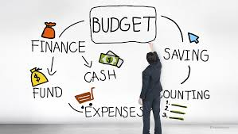
The Good-Financial Responsibility: Why we uphold this virtue
It is our responsibility to see the project completed as best we can
Want an expenditure of our budget prevents the final product from providing to the target demographic as best it can.
If the target audience is not as satisfied as it could be the project is not the best it can be.

Slide 6
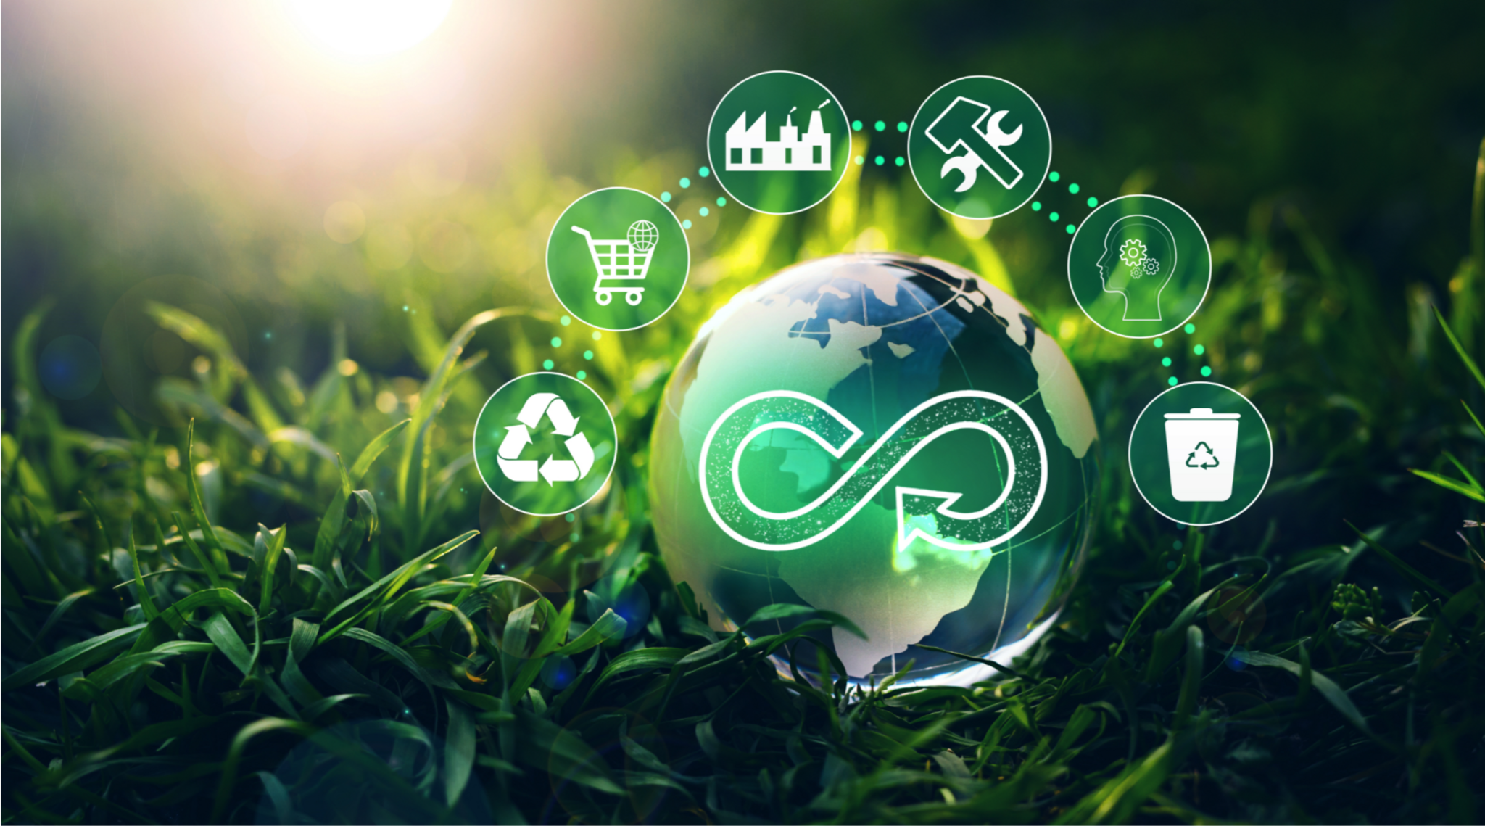
The Bad-Sustainability: Relevance
What our products will be at the very end of its design cycle is a mass market consumer device which exists to increase convenience
Any device which is mass produced will have some kind of environmental impact
It is our responsibility to limit this environmental impact through the selection of components and manufacturing methods which are both sustainable and environmentally friendly as possible

Slide 7
The Bad-Sustainability: Our Approach
Currently no moves have been made to ensure the components of the device are sustainable focusing mainly on ensuring the components fit within our budget
Resulting in us selecting components that feature production with ambiguous environmental impact

Slide 8
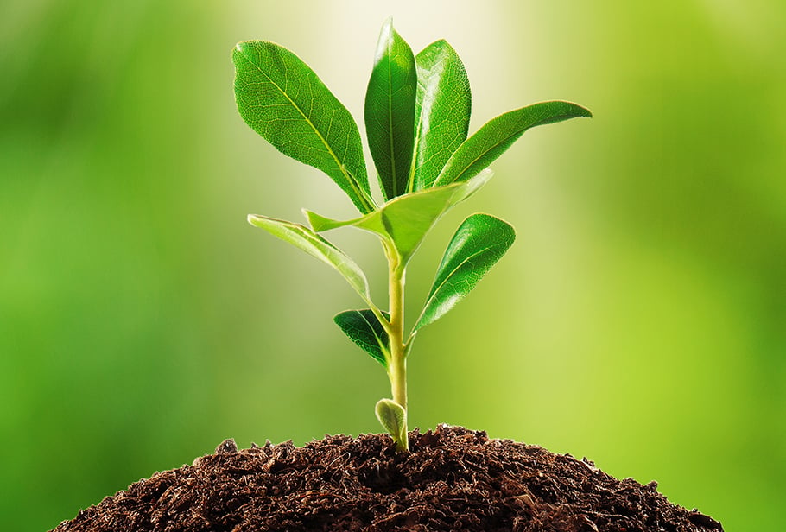
The Bad-Sustainability: Future Plans
After the first prototype of the device is completed we will begin to research on the manufacturing process of various components and searching for alternatives if need be.

Slide 9
The Ambiguous-Health Safety and Wellbeing:Relevance
Our device is currently designed with the intention of pairing it with a liquid fertilizer reservoir. Highly Nitrogenated fertilizer can pose a fire/explosion hazard.
It is our responsibility to prevent such an event from occuring by designing our reservoirs in such a way that they will mitigate the potential risk.

Slide 10
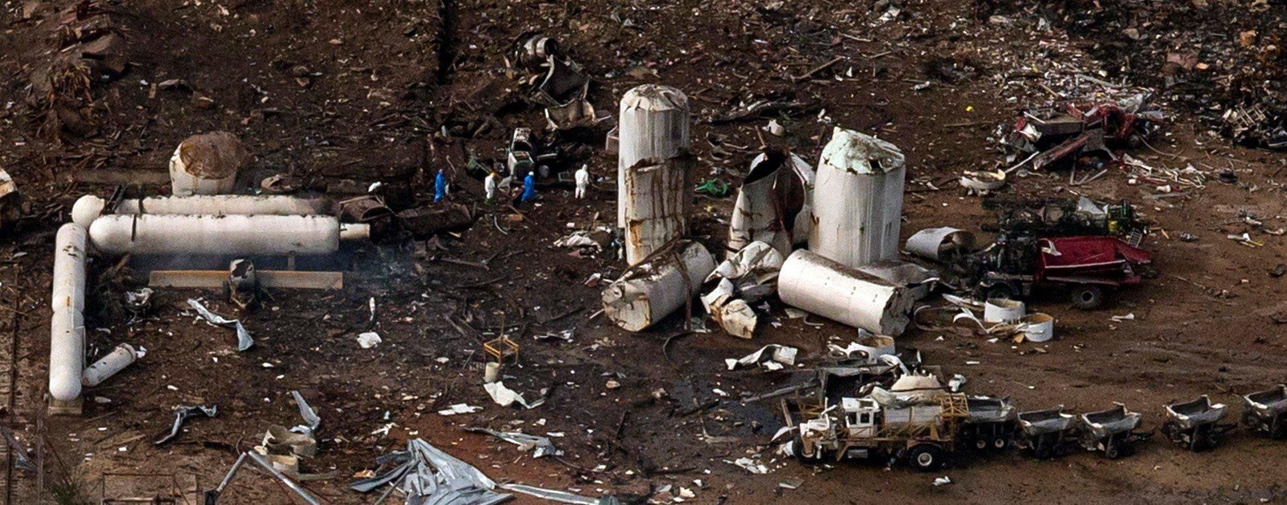
The Ambiguous-Health Safety and Wellbeing: Our Approach
Little to no research has been done regarding this potential issue such as the actual likelihood of fire breaking out or what could cause a fertilizer related fire, for this reason, we don’t currently know how much importance to put on this issue, or if ignoring such an issue is unethical

Slide 11
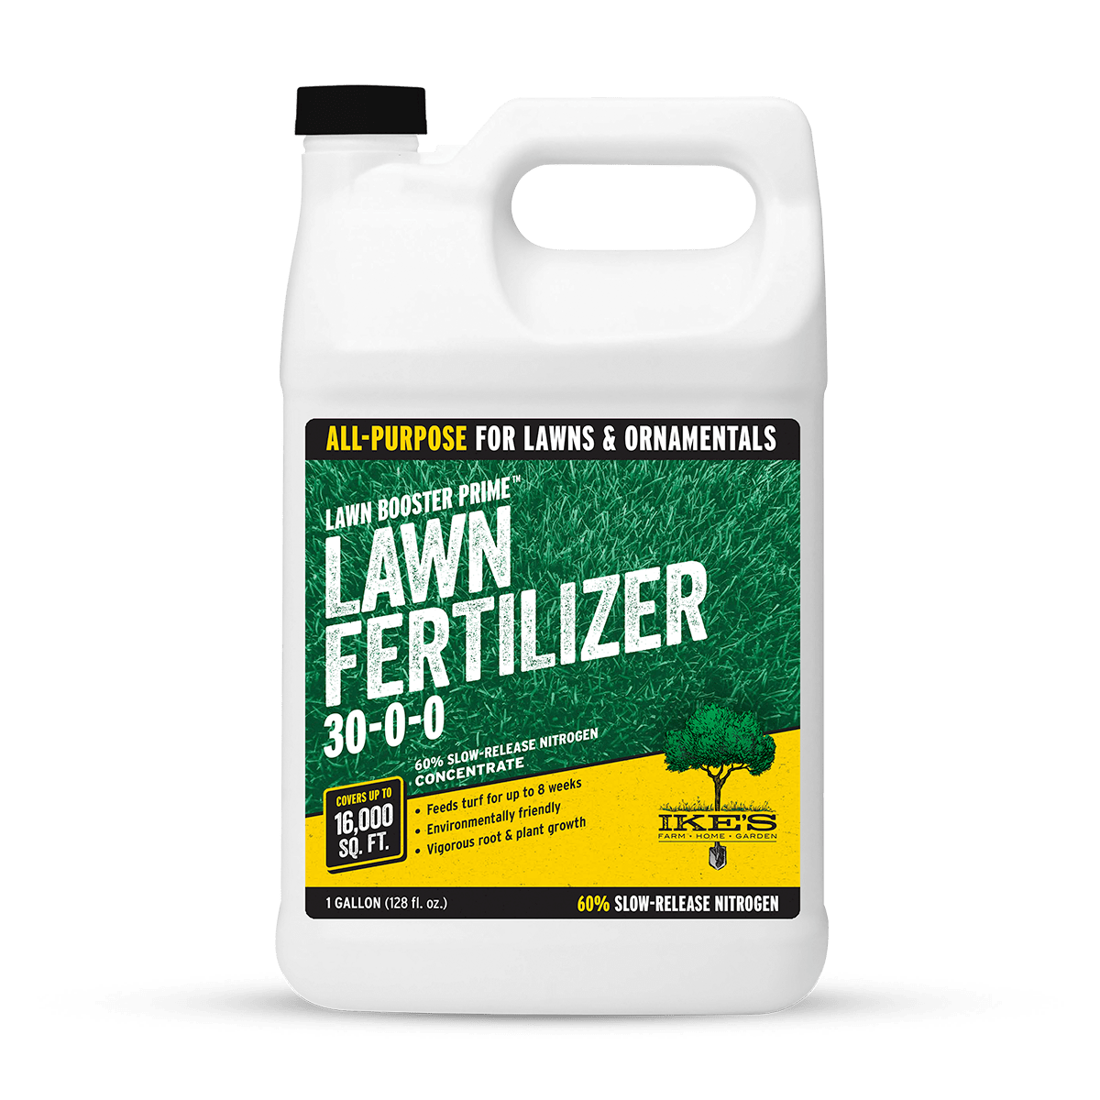
The Ambigous-Health Safety and Wellbeing: Future Plans
To rectify this we will perform research to find out the level of threat having liquid fertilizer out near ones house for long periods of time can pose and help rectify the design to accommodate this possible risk.

